Slide 1
WW1 comes to an end

Slide 2
War poetry
Read the poems, The Third Battle of Ypres and War, and consider the following questions:
What is the overall message?
What kinds of emotions do these poems stir?

Slide 3
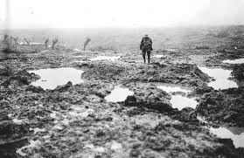
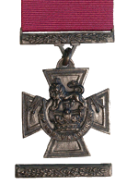
Battle of Passchendaele (3rd battle of Ypres)
November 1917, Belgium
Offensive began on July 31, 1917
Over 100,000 British casualties
Atrocious conditions, heavy casualties, Canadian heroism
Canadians capture the ridge within a week
(October 30 – November 6)
Canadian troops established as an elite fighting corps
9 Victoria Crosses awarded

Slide 4
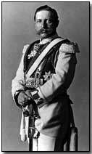
“Hundred Days”
August 8, 1918 – November 11, 1918
Series of offensives on the Western Front
Final offensive spearheaded by Canada
Broke through Germany’s “Hindenburg Line” in NE France
Germans utterly exhausted
War was over!
German Kaiser Wilhelm II abdicated and fled to Holland
Armistice signed on November 11, 1918 at 11am

Slide 5
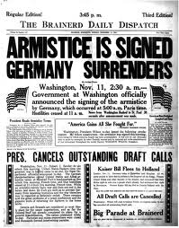
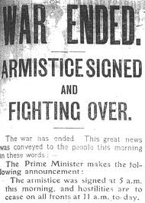
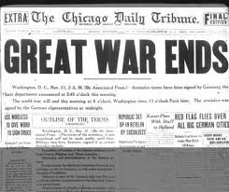
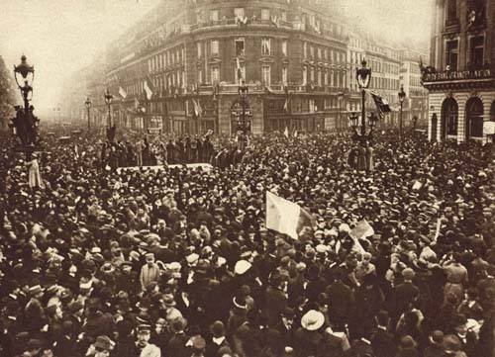
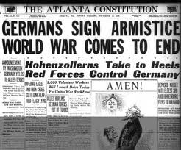
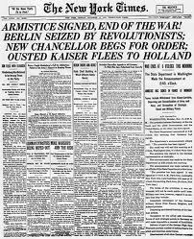

Slide 6
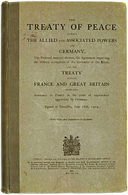
Treaty of Versailles
June 28, 1919
Biggest peace conference ever
Led by the “Big Three”
David Lloyd George – Britain
Georges Clemenceau – France
Woodrow Wilson – United States of America
Canada received its own seat!
Germany not part of negotiations, but forced to sign

Slide 7
Creation of the League of Nations
Germany to accept the “War Guilt Clause”
Germany to pay war reparations totalling ~$30 billion
Restrictions on German military
No more than 100,000 troops
No U-boats or Air Force
Demilitarization of the Rhineland
Map of Europe redrawn
Reduction of Germany’s territory
German colonies surrendered to Allies

Slide 8
Debate
Canada’s participation in World War 1 was positive for the country as a whole

Slide 9
Homework!
Which of the terms determined in the Treaty of Versailles do you consider to be fair treatment for Germany?
Which are unfair?
“The Treaty of Versailles contains the seeds of another war.” What does this quote mean? Why would the author say this?
With all of the knowledge you now possess, propose an alternate treaty/solution to the war.

