Slide 1
The war at home
Conscription
The role of Canadian women

Slide 2
Group debates
Record your group consensus (or lack thereof) after each question
Is it appropriate to manipulate information for patriotic purposes during war?
What differences are there, if any, between propaganda and advertising?

Slide 3
Group debates
Is there such thing as a justified war?

Slide 4
Group debates
If Canada declared war on an enemy nation, would you volunteer to serve in the armed forces? Why or why not?

Slide 5
Group debates
Should the government have the power to force people into military service? Never? Maybe? Under what circumstances?

Slide 6
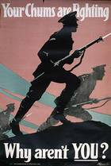
The conscription crisis
By 1916, enlistment was had dropped
From 134,000 to 36,000
Other reasons not to join:
Employment was up
Not an adventure
Obviously not a quick war
French-Canadians opposed
No patriotic ties to Britain
Ill-treatment

Slide 7
# of volunteers was not sufficient in replacing the large number of those wounded or dead
Borden was convinced more people were needed
Originally promised there would be no compulsory enlistment
Attempted to form a coalition government
Laurier declined
1917 Election:
Borden introduced Military Voters Act
Allowed men and women serving overseas to vote
And Wartime Elections Act
Allowed all Canadian women related to servicemen to vote as well

Slide 8
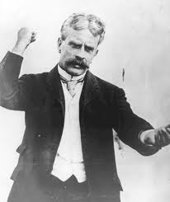
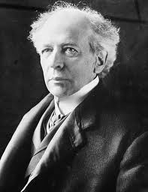
Union Government
Borden’s Conservatives + others who favoured conscription
Union government won 1917 election
Liberals lost significant support outside of Quebec

Slide 9
August 29, 1917: Borden introduced the Military Service Act
404,385 men were called; 380,510 appealed
Conscientious objectors joined non-combatant corps
Did not fight, but performed work that supported those who did
Ex. potato peeler, stretcher-bearer
Other objectors were abused, deemed a coward, and stripped of their basic needs and rights

Slide 10
Easter riots
March 28, 1918: French-Canadian man arrested
Riot broke out at the conscription registration office & two pro-conscription newspaper offices in Quebec City
780 federal soldiers sent from Ottawa
April 1, 1918: 4 demonstrators shot and killed by soldiers
Over 150 casualties & $300,000 in damage

Slide 11
Power to the women
With men overseas, women took on new roles
Some organized committees to send food & letters overseas
Other got involved in volunteer organizations (ex. Red Cross)
Most significant = contribution to the labour force
Munitions production, farmer work, fishing, building aircrafts, etc.
Although women were not on the front lines,
without their efforts on the home front, Canada’s wartime economy would have collapsed

Slide 12
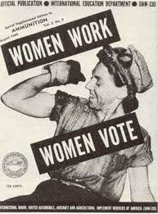
Empowered by their contributions, women pushed for the vote…
1917: Women with family in the CEF were given the vote
(To support conscription)
May 1918: all women over 21 were permitted to vote

Slide 13
“And We Knew How To Dance”
“It’s World War 1, and many of the country’s men have gone into battle. Twelve Canadian women, aged 86 to 101, recall their entry into what had been a male world of munitions factories and farm labour. Their commitment and determination helped lead the way to postwar social changes for women.”
http://www.nfb.ca/film/and_we_knew_how_to_dance

