Slide 1
Human Geography
The Future in Balance

Slide 2
What is this unit all about?
Population
Distribution, Increase, Aging
Disparity between rich & poor
Poverty
Developed vs. Developing nations
Standards of living
Environment
Carbon emissions, Sustainable living
Health crises
Water

Slide 3
World population growth
Two thousand years ago, there were approximately 300 million people on earth
In 1804, there were 1 billion
The 20th century began with a world population of under 2 billion people
At the end of the 2oth century, that number tripled
Today, 76 million people are added to the Earth’s population every year!

Slide 4
The United Nations determined that the world population reached 7 billion on October 31, 2011
Based on Figure 11-1 on pg. 358, when was the global population originally expected to reach 7 billion?

Slide 5
one million vs. one BILLION
You had lived one million seconds when you were 11.6 days old…
You won’t be one billion seconds old until you are 31.7 years old!

Slide 6
Do you think population growth is good/bad for the planet & for humanity?
Why or why not?

Slide 7
Demography
Definition:
The statistical study of the characteristics, trends, and issues of human populations
Population change is an ongoing concern
For government:
For businesses:

Slide 8
How do we collect this information?
In Canada, a major census is conducted every 10 years
A less detailed one every 5 years
Conducted by a federal agency called Statistics Canada
All Canadians are required by law to be counted

Slide 9
Discuss…
What does the census tell people about Canadians?
If you submitted your form, would the government have full and accurate information about your family and everyone living in your house?
Do you think Canada has accurate census information for its population? Why or why not?
What might this data be useful for?

Slide 10
Population change
The 4 basic components of population change are:
How many people are born – birth rate
How many people die – death rate
How many move into a region – immigration rate
How many move out of a region – emigration rate

Slide 11
Birth rate
The number of children born in a region for every 1,000 inhabitants
Calculated by dividing the number of births in one year by the population
Then multiplying the result by 1,000

Slide 12
Death rate
The number of people who die in a region for every 1,000 inhabitants
Canada’s death rate is 7.4 deaths per 1,000 Canadians

Slide 13
Natural increase
Subtract death rate from birth rate
** This figure does not include the increase that comes from immigrants **

Slide 14
The exponential rate of increase explains that human population does not increase at the regular arithmetic rate
A convenient way of expression exponential population growth is to use the length of time it would take for a population to double
Rule of 70 states that doubling time is 70 divided by the growth rate (in percentage) per year

Slide 15
Try it!
Calculate the doubling time for India and Russia
(Refer to figure 11-7 on pg. 362 of Counterpoints)
Homework:
Counterpoints: Pg. 364 #4-5
Read pg. 365-374

Slide 16
The demographic revolution
Revolution = “A turnaround”
For the most of human history, up to before the 1700s, population growth was slow
Death rates were high
Disease, poor medical care, poor nutrition, unsanitary living conditions, etc.
Families had many children
Make sure that a few would survive
Help out on the farm
Caretaker for parents

Slide 17
A history of population
Average life expectancy was ~30 years
After 1750, drastic decrease in death rate
Improvements in diet, living conditions, preventative medicine
Overall improvement in quality of life
Birth rates remain high

Slide 18
Result…
RAPID POPULATION GROWTH

Slide 19
Birth rate begins to decrease
The Great Depression & WW2 kept birth rates low in most Western countries
Today, Western countries experience a lower birth rate and longer life expectancy
Due to modernization, improvement in technologies, change in culture, expenses, etc.

Slide 20
Demographic transition model
Model: simplify information and make it more easily understandable
DTM: based on changes in natural increase in several countries
(in Western Europe & North America)

Slide 21
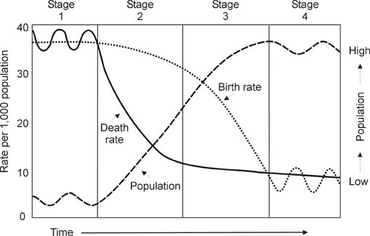
Shows changes over a period of time in 3 elements:
Birth rates
Death rates
Overall trends in population

Slide 22
DTM: divided into 5 Stages
STAGE 1
High birth rate
High death rate
STAGE 2
High birth rate
Decreasing death rate
STAGE 3
Decreasing birth rate
Low death rate
STAGE 4
Low birth rate
Low death rate
STAGE 5
Birth rates drop below death rates

Slide 23
Be careful…
DTM is based on what has happened in developed countries
Key: population growth rates of countries that are industrializing go through a series of transitions

Slide 24
Population profiles
(aka Population pyramids, aka Age Structure diagram)
Reveals the age & gender structure of a population
Displayed as two back-to-back bar graphs
Population plotted on the X-axis
Age plotted on the Y-axis

Slide 25
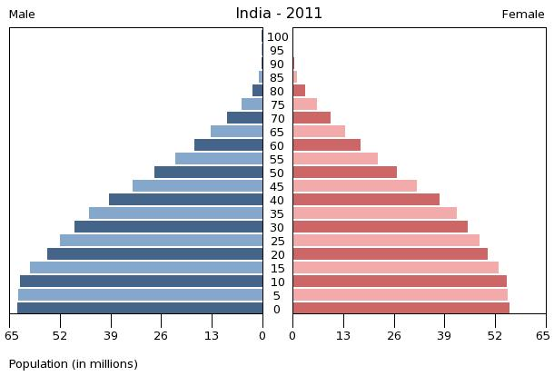
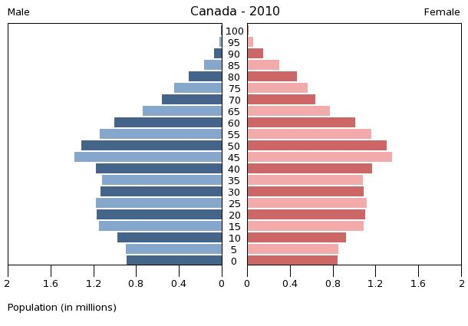
For example…

Slide 26
REVIEW

Slide 27
http://www.statcan.gc.ca/kits-trousses/animat/edu06a_0000-eng.htm
1956 – 2006
Describe the changes you see from the animation
Make a prediction for the future of Canada’s population

Slide 28
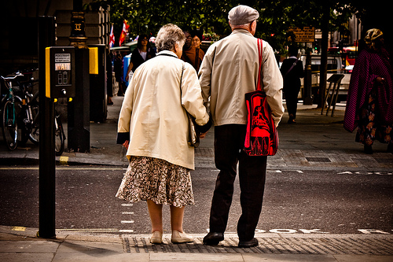
Canada’s population
Birth & death rates have been dropping steadily
Population is getting older
In 1951, 1 in 13 were over 65
In 2020, estimated that 1 in 5 will be over 65

Slide 29
An aging population
One of the biggest changes taking place in the developed world today is aging
In Canada, baby boomers make up more than 30% of the population
In BC, 65+ make up 15% of the population, up from 10% in 1979… And is expected to reach 23% by 2030
Trend is the same for most developed countries

Slide 30
Implications
Increased dependency ratio
Ratio of those not working to those who are working
Ratio of youth & senior to working-age population
Estimated 84 dependents for every 100 people of working age by 2056
50 seniors; 34 youths
More people are moving out of the working age range than into it

Slide 31
An aging population has consequences that affect various aspects of society
Health care: Increase in disease & disabilities
Exploding health care expenditures
Reconstruct health care system

Slide 32
Strained labour force
Fastest growing portion of the population will soon be leaving the work force
Do we have enough people to fill their places?
Potential solutions:
Increase productivity among the smaller labour pool
Encourage retirement-aged workers to stay
Immigrants!

Slide 33
Canada looks to immigrants
Immigrants who arrived during the 1900s accounted for ~70% of the labour force growth between 1991 and 2001
Stats Canada expects it to soon become 100%

Slide 34
Examine the maps on pg. 380 & 381
Where do people tend to live?
What is the relationship between population distribution & climate/topography?
Which two continents are most densely populated? Are they located north or south of the equator?
Come up with a list of reasons that might account for the density in these two continents.

Slide 35
Human Development Report
Human Development Index (HDI)
Ranks standard of living in UN member countries according to 3 indicators:
Life expectancy
Literacy rate
GDP per capita

Slide 36
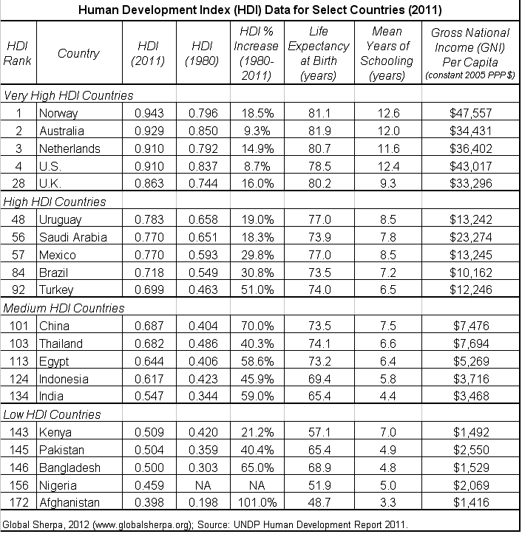

Slide 37
Human development report
Gives information about different levels of economic and social development
Huge gap between the top 10 and bottom 10 countries

Slide 38
“Developed” vs. “Underdeveloped”
“Developed” countries
Industrialized, people well-housed, healthy, possess generally good literacy skills
Well-developed infrastructure – transportation, communication, electric-power, schools, hospitals, etc.
“Underdeveloped” countries
Few schools, doctors, hospitals, unpaved roads, few telephones, limited electrical power

Slide 39
Developed countries
The world’s wealthiest countries
Newly industrializing countries
Countries experiencing rapid economic and industrial growth
Likely switching from agricultural to industrial economies
Developing countries
Countries that have lower standards of living than developed countries; many have extensive poverty
Heavily indebted poor countries (HIPCs)
Countries at the low end of the HDI that are in debt to developed nations

Slide 40
Interesting statistics…
(2009)
85 countries worse off than they were in the 1980s
Life expectancy below 50 in more than 34 countries
Wealth of the 200 richest people in the world (nearly $800 billion) is greater than the combined income of ~40% of the world’s population

Slide 41
Closing the development gap
2000: major worldwide initiative launched to close the gap and living standards between developed & developing countries
All member states of the UN adopted eight Millennium Development Goals (MGDs)
By 2015, the world would have less poverty, hunger, and disease
Greater survival rates, education for all, equal opportunities for women, and an improved physical environments

Slide 42
How?
Partnership between developed and developing countries!

Slide 43
Exit slip
Determine which 3 MGDs you think are the most important. Provide reasons.
Which 2 goals do you believe are most likely to be met? Which are the least likely to be met?
WHY?

Slide 44
Poverty
Definition:
The state of one who lacks a certain amount of material possessions or money
Relative poverty:
Lacking a level of resources or income as compared with others within a society or country
Absolute poverty/Destitution:
One who lacks basic human needs
Clean & fresh water, nutrition, health care, education, clothing, shelter

Slide 45
About 1.4 billion (1 in 4) people are estimated to be living in absolute poverty today
Poverty…
Is measured differently in developed & developing countries
Most common measure: poverty line
The minimum income required to pay for basic needs
In developing countries, the absolute poverty line is ~$1.25/person/day

Slide 46
Key player
World Bank
Official goal: Reduction of poverty
An international lending agency
Provides loans to developing countries

Slide 47
The poverty trap
About 1 billion people in developing countries go hungry every day
But… the world produces enough food to feed everyone on Earth!!!
Problem:
People cannot afford the food that is available

Slide 48
Key player
International Monetary Fund
Objectives: Promote international economic cooperation, international trade, employment, and exchange rate stability

