Slide 1
to SS11!

Slide 2
You must be thinking, “She’s not Mr. Anderson...”

Slide 3
Class Expectations
Late for class
Homework not completed on time
Talk out of turn
Use of disrespectful language
Cellphone use in class
Define “RESPECT”
- Taking notes…

Slide 4
Course Outline
MUST BE SIGNED BY YOURSELF AND A PARENT OR GUARDIAN BY FRIDAY, FEBRUARY 3
I WILL BE CHECKING!
Units:
Government & Human Rights
Human Geography
Canadian History: 1900-1914
World War 1

Slide 5
http://msjwong.weebly.com
You are responsible for printing out the handouts and worksheets for each unit
I strongly advise you do it all at once

Slide 6
Current Events
Presentations every Friday, starting this week
If there is no school on Friday, presentations will be Thursday instead
You must sign up for a presentation date and it is your responsibility to remember your date
Submit your written report on your presentation date
Do not leave this to the last minute!

Slide 7
What does it mean to be “Canadian”?

Slide 8
What image is portrayed about Canadian identity?
http://www.youtube.com/watch?v=X_yW4-cgG4g
http://www.youtube.com/watch?v=TL01SReeOqE&feature=related
http://www.youtube.com/watch?v=rLdA2PfwzTQ
http://www.youtube.com/watch?v=soa5qhaZ-hI&feature=related
http://www.youtube.com/watch?v=BRI-A3vakVg

Slide 9
Discussion Questions:
WHAT or WHO is a Canadian?
What CONCEPTS define Canada?
What IMAGES or SYMBOLS define Canada based on what you observe through the media?
Are they accurate? Why, or why not?
What have you experienced in daily life that reflects Canadian identity and a Canadian society?

Slide 10
Reflection on Canadian Identity project
DUE TUESDAY, FEBRUARY 7
Design a poster, write a poem, song, or story, which expresses your feelings about being a Canadian
Students will be randomly selected to present their projects to the entire class
All projects will be posted for display

Slide 11
Government systems & ideologies

Slide 12
Government ideologies
Ideology: political and/or social principle
Guides everything you do – goals, expectations, actions
Canada = democracy
Democracy: “rule by people”
Direct vs. Representative
Main principles: equality and freedom

Slide 13
Democratic philosophies
Socialism
Primary goal: social equality
Liberalism
Classical vs. Reform
Primary goal: individual freedom
Conservatism
Primary goal: maintaining tradition

Slide 14
Other ideologies…
Totalitarianism (Authoritarianism)
Government controls everything
Communism
Classless society
Fascism
People serve the state

Slide 15
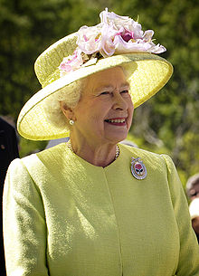
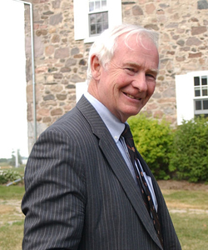
Government system
Constitutional monarchy
The Crown = Queen Elizabeth II
As of October 1, 2010: Federally represented by Governor General David Lloyd Johnston

Slide 16
Levels and Branches of Government
What immediately comes to mind when you hear the terms, “government”, “parliament”, “law”?

Slide 17
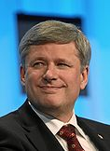
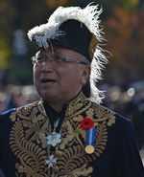
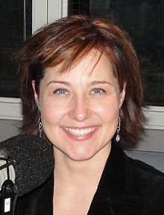
Levels of government
Federal government
Headed by the Governor General & Prime Minister
David Lloyd Johnston & Stephen Harper
Provincial government
Headed by the Lieutenant Governor & Premier
Steven Point & Christy Clark
Municipal government
Headed by the Mayor
Malcolm Brodie

Slide 18
Branches of government
Executive branch
Administers and carries out laws
Legislative branch
Makes and amends laws
Judicial branch
Decides who has broken the law and determines penalties

Slide 19
Branches of government
Executive branch
Governor General, Prime Minister, Cabinet, Bureaucracy http://www.parl.gc.ca/MembersOfParliament/MainCabinetCompleteList.aspx?TimePeriod=Current
Legislative branch
Governor General, House of Commons, Senate
http://www.parl.gc.ca/Parlinfo/Lists/Members.aspx?Parliament=1924d334-6bd0-4cb3-8793-cee640025ff6
http://www.parl.gc.ca/SenatorsMembers/Senate/SenatorsBiography/ISenator.asp?Language=E
Judicial branch
9 judges, appointed by the Governor General

Slide 20
Process of supreme court of Canada appointments
Eligibility & Representation
In choosing an appointment to the Supreme Court, the Prime Minister must observe several rules:
Must have specific professional reference
An appointee must either 1) be or have been a judge of a superior court of a province or 2) have been a barrister (lawyer) or advocate with at least 10 years standing at the bar of a province
At least 3 of the judges on the Court must be appointed from Quebec
The remaining 6 positions are divided with 3 from Ontario, 2 from Western Canada, and 1 from Atlantic Canada

Slide 22
For example…
The _____________ Branch would create a law about the time of year that a person could fish.
The _____________ Branch would see to it through by setting up various ministries and agencies to ensure that people only fished during that time.
The _____________ would put anyone on trial that broke the law and fished outside of the allotted time and would decide upon an appropriate punishment.

Slide 23
In groups of 4…
Be prepared to share with the class how much of an influence, on a scale of 1-10, you feel that the different levels of government have on your lives
Identify specific examples of how you are impacted

Slide 24
Who’s Who in the Federal Government
Current events presentations

Slide 25
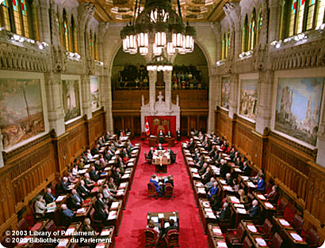
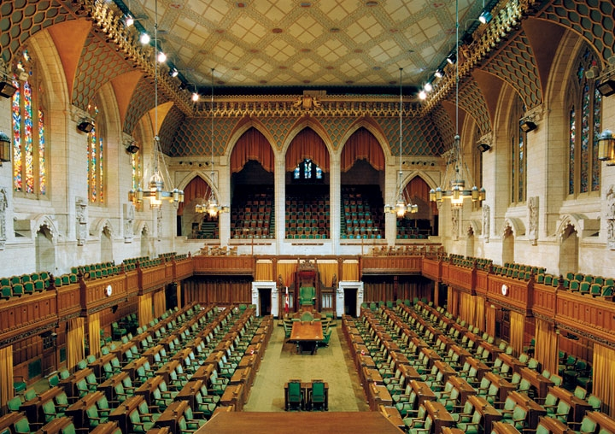
SIMILARITIES?
DIFFERENCES?

Slide 26
Review…
Levels - Responsibility | Levels – Who is involved (Include names) | Branches - Responsibility | Branches – Who is involved (Include names)
Federal | Federal | Federal | Federal
Provincial | Provincial | Provincial | Provincial
Municipal | Municipal | Municipal | Municipal

Slide 27
Legislative branch
The Crown & Two houses:
House of Commons (The Lower House)
Members of Parliament (308, as of 2011)
MPs are democratically elected
Seats are distributed roughly in proportion to the population of each province and territory
More powerful than the Senate

Slide 28
Legislative branch
Senate (The Upper House)
“Order or precedence” = symbolic hierarchy of important positions within the Government
(ceremonial protocol)
Senators (105)
Appointed by the Governor General
Seats are assigned on a regional basis
Ontario, Quebec, Maritime provinces, Western provinces
Once appointed, may serve until age 75

Slide 29
Key terms and figures
Define/Describe
Specify names; Provide examples

Slide 30
Reflection on Canadian Identity projects are due Tuesday, February 7
You will have a portion of Monday’s class to work on your projects
Make sure you bring whatever you need to use the class time productively!!!

Slide 31
The Senate
http://www.youtube.com/watch?v=iM2WuAPef_Q&feature=related

Slide 32
Review…
How does someone become a Member of Parliament in the House of Commons?
How does someone become a Senator?
What are the issues we discussed last class about how seats are distributed in the Senate?

Slide 33
Consider…
Population of Western provinces: ~10,510,100
Population of Maritime provinces: ~1,826,896
# of seats in the Senate:
Western provinces: 24
Maritime provinces: 24

Slide 34
The senate
Originally designed to give a “sober second thought” to legislation
Was comprise of men of rank or status who owned property
Why?
Ensure the elected body is held accountable

Slide 35
Should the Senate be reformed or abolished?
Controversies:
Seen as useless, unfair, undemocratic
Ontario & Quebec have far more representation than the West
No prerequisites for members to be appointed
Members are not held accountable for their service

Slide 36
Should the Senate be reformed or abolished?
Proposal by Stephen Harper & the Conservatives:
“Triple-E Senate”
Elected
Senators should be elected, just like the MPs
Effective
Senators should hold real power and be held accountable
Equal
Fair representation

Slide 37
In-class assignment
Read Counterpoints, pg. 303:
“Romeo Dallaire: The Ideal Senator?”
Answer questions 1 & 3

Slide 38
The Cabinet

Slide 39
Review…
Who are the main players in the executive branch at the federal level?

Slide 40
The executive branch
Prime Minister
Chief Minister of the Crown
Head of the Cabinet
Has considerable powers:
Chooses Cabinet members
Directs activities of the legislature
Has the right to be consulted on all important Cabinet decisions
Controls appointments to the Senate & Judiciary
Can adjourn or dissolve Parliament and call an election

Slide 41
The executive branch
Cabinet
Ministers are selected by the Prime Minister
- Ministers are usually members of the governing party
& also have a seat in the House of Commons
Is responsible for the smooth running of government and the spending of public money - Each Minister is responsible for a department of the government, called a portfolio
- Once appointed, is held responsible for everything that happens in their department, (ministerial responsibility)
Holds a substantial amount of power in the federal government

Slide 42
The executive branch
Controversies:
Weakening of responsible government
PM and Cabinet are not directly elected
Cabinet solidarity & secrecy
Decisions aren’t always made collectively
Cabinet members are expected to publicly defend all Cabinet policies
Information about Cabinet deliberations are not disclosed
Under-representation in the Cabinet

Slide 43
Cabinet Ministers
What commonalities do you notice in the following photographs?
Nearly all minorities and vulnerable groups are un- or under-represented in the Cabinet

Slide 44
Quiz!
WHAT!? Up-coming quiz!
WHEN!? Wednesday
WHAT’S ON IT!? All of the material covered in class and in the textbook, including today
Homework: Read pg. 308
We will be doing an activity next class that requires comprehensive understanding of this process, further research is not a bad idea…
Please bring a GLUE STICK and SCISSORS for next class

Slide 45
Passing bills

Slide 46
Review…
In order of most to least, rank the following according to degree of power and influence:
Governor General
Prime Minister
Cabinet Minister
Senator
Member of Parliament
Leader of the Opposition
Canadian Citizen
Supreme Court Judge
RCMP
Queen Elizabeth II

Slide 47
Passing bills
One of the most significant tasks of Parliament
A bill only becomes a law after it goes through three readings in the House of Commons, is amended by a special committee, passes a reading in the Senate, is signed by the Governor General, and then finally proclaimed

Slide 48
Stages
Cabinet
A policy is proposed to a Cabinet committee for approval
Responsible Minister drafts a bill to be approved by the Cabinet
If approved, bill is presented in Parliament

Slide 49
Stages
First reading:
Bill is printed and circulated
Second reading:
MP’s debate and vote; may refer the bill to a Committee to be revised
Committee stage:
Study bill clause by clause, composes a report, recommend that bill be: 1) accepted as is, 2) with amendments, 3) not be proceeded with further

Slide 50
Stages
Report stage:
Committee reports recommendations to the House, Members of the House may suggest changes to the bill
Third reading:
Debate and vote on the amended bill, send to Senate
Senate stage:
Senators debate and vote on the bill
Royal assent:
Bill is presented to the Governor General

Slide 51
Royal assent
Governor General may:
Assent in the Queen’s name
Withhold assent
Reserve assent
Once a bill is given royal assent, it becomes LAW!

Slide 52
Role Play
First reading
Majority group presents proposal
Second reading
Majority group expresses principles and arguments in favour
Opposition group presents counter-arguments against
Committee stage
Make changes to the proposal
Third reading
Committee presents amendments
Vote

Slide 53
Exit slip
Why are there so many steps in the process of making laws?

Slide 54
Electoral Process
Quiz!
Put up a “wall” between you and your neighbour so you don’t get tempted to peek
All you need is a pen on your desk

Slide 55
Elections
Federal elections are held at least every 5 years
PM can call an election at any time
Held on Mondays (Tuesday, if Monday is a holiday)
In BC, the next scheduled election is May 14, 2013
You may cast a ballot if:
You are over the age of 18
You are a Canadian citizen

Slide 56
Majority vs. Minority
Majority government
The political party who has over half of the seats in the House of Commons is the governing party
More powerful than a minority government

Slide 57
Majority vs. Minority
Minority government
The governing party has more seats than any other party, but the other parties combine have more seats
Must compromise in order to stay in power
More democratic
BUT hesitant to make important changes because of fear of defeat

Slide 58
Coalition government
No party wins a majority, so 2+ parties join together to form a government
Might also be created in a time of national difficulty or crisis, to give the government a high degree of perceived political legitimacy

Slide 59
Voting process
First-past-the-post :
Winner simply has to win with more votes than any other candidate
# if seats in legislature = # ridings won
Advantage
Promotes a link between constituents and their representatives (elected members represent defined areas)
Disadvantage
Result excludes smaller parties and minorities from “fair” representation

Slide 60
Voting process
Proportional representation :
Political parties receive seats in proportion to their share of the national vote
% of votes received in election = % of seats in legislature
Advantage
Any party with even a few % will gain some representation in government
Disadvantage
Minority/coalition governments likely because difficult for one party to receive more than 50% of the vote

Slide 61
Voting process
Single transferable vote
Goal: To achieve proportional representation through preferential voting
Rank-order as many or as few candidates as you like
If 1st choice doesn’t get elected, 2nd choice becomes new 1st choice
Advantage
Votes don’t go to waste
Disadvantage
Takes a genius to fully understand

Slide 62
Voting process
Single transferable vote
Proposed as a new voting system in BC
Supported by a majority (57.7%) in 2005, but government had legislated that it required 60% in favour to pass
Second referendum in 2009, but was again rejected, this time with only 39.1% in favour

Slide 63
The Political Spectrum
Current events presentations

Slide 64
The political spectrum
Helps to illustrate how various political ideologies relate to one another
Left wing (more liberal)
Supports change for improvement of welfare for citizens
Government should play a significant role
Social services, benefits, etc.
Right wing (more conservative)
Values tradition, cautious of change
Feels government should have little interference

Slide 65
Our national political parties
Mostly clustered around the centre of the spectrum
The best way to understand a party’s ideology and differentiate one party from another is to look at their position on important issues

Slide 66
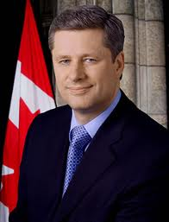
Conservative Party
Most right-winged
Supports tradition and privatization
Nationalistic
Supports the military

Slide 67
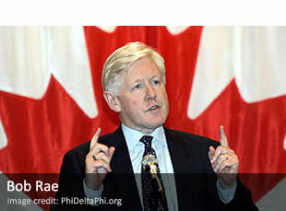
Liberal Party
Promotes social programs (ex. universal health care)
Places less emphasis on the military
More support for the arts and culture

Slide 68
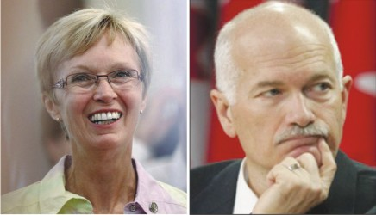
New Democratic Party
Most left-winged
Supports government-funded social assistance programs, health care, and education
The most Socialist of all major political parties

Slide 69
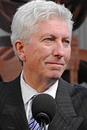
Bloc-Quebecois
Main objective: To protect the interests of Quebec and support Quebec sovereignty
Campaigns only within the province
Won only 4 seats in the 2011 election

Slide 70
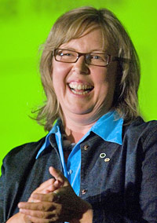
Green Party
Dedicated to achieving environmental goals, social justice, and non-violence
In 2008, was invited to participate in debates for the first time
Received less than 4% of the popular vote
in 2011 election
Elizabeth May become the first elected
Green Party MP to sit in the House of
Commons

Slide 71
Canadian Charter of Rights and Freedoms

Slide 72
Hutu vs. Tutsi
http://www.youtube.com/watch?v=KqwhlSgdhrg&feature=related
Is there anything that protects Canadians from this injustice? What?
Based on what you know (or don’t know), describe the Canadian Charter of Rights and Freedoms.
Compose a list of 5 rights that you believe every individual should have

Slide 73
The Canadian Charter of Rights and Freedoms
Passed in 1982
The part of the Canadian Constitution that has the greatest impact on Canadians’ everyday lives
Guarantees certain political rights to Canadian citizens And civil rights to everyone in Canada
Gives Canadians the right to challenge, in court, any law they believe violates their rights

Slide 74
The Canadian Charter of Rights and Freedoms
Reasonable limits clause (s.1)
Legally allows the government to limit an individuals’ Charter rights
Reason: to prevent “objectionable conduct”
Ex. James Keegstra

Slide 75
The Canadian Charter of Rights and Freedoms
Notwithstanding clause (s.33)
Allows governments to pass a law even if it violates a specific freedom or right
Temporary (lasts up to 5 years)
Requires a majority vote in the jurisdiction
Ex. Quebec, Saskatchewan, Alberta

Slide 76
Activity!
In groups of 4, create a 3-column chart
Right/Freedom | Explanation | Example
Fundamental freedoms
Democratic rights
Mobility rights
Legal rights
Equality rights
Official language rights
Minority language educational rights
Rank-order the sections of the Charter in terms of historical significance and impact on the lives of Canadians

Slide 77
Read the Notwithstanding Clause article and answer the following questions:
How does the Notwithstanding Clause help our politicians to have the final say over the judiciary?
Why might elected officials be reluctant to use the Notwithstanding Clause?
What does their reluctance mean to the courts?
What areas of the Charter are covered by s.33, and which are exempt?
Do you think it is a good idea to have the Notwithstanding Clause as part of the Charter?
What does this Clause do to our guarantee of basic rights and freedoms?

Slide 78
The Japanese-Canadian Experience
Current events presentations:
Susanna, Anthony, Kimberly

Slide 79
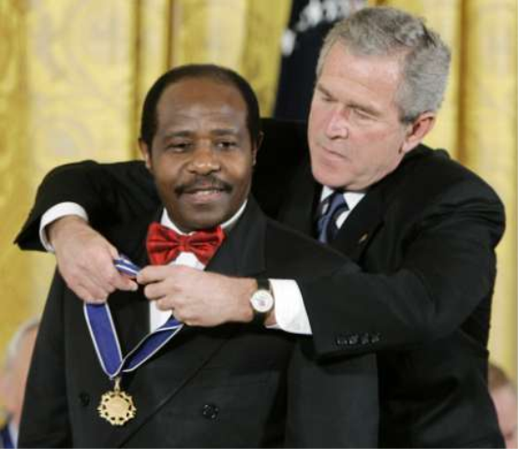
HERO OR VILLAIN?

Slide 80
Intro activity
With your neighbour, create a KWL chart about:
Japanese internment in Canada during WW2
WHAT WE KNOW
WHAT WE WANT TO KNOW
WHAT WE HAVE LEARNED

Slide 81
Pre-war conditions
23,000 Canadians of Japanese descent living in BC prior to World War 2
80% Canadian nationals
Immigration began at the end of the 19th C
Immigrants were unwelcome and subject to racism & discrimination

Slide 82
Pre-war conditions
Denied the right to vote
Barred from certain professions
Restricted on eligibility for social assistance
Government regulated the number of passports issued to Japanese immigrants
Intent: force Japanese immigrants to return “home”

Slide 83
Internment camps
Began in December, 1941, following attack on Pearl Harbor
Internment order issued by Mackenzie King
Based on speculation of sabotage and espionage
Was no actual proof
February 24, 1942: Federal government was given the power, under the War Measures Act, to intern all “persons of Japanese racial origin”

Slide 84
Internment camps
22,000 Japanese-Canadians were interned
14,000 of whom were born in Canada
Able-bodied men (18-45) were sent to labour camps
Removed from jobs, redirected to farming
Canadians were unaware of the awful living conditions within these camps
Placed in barnyards and stables
Conditions were so poor the Red Cross sent food supplies

Slide 85
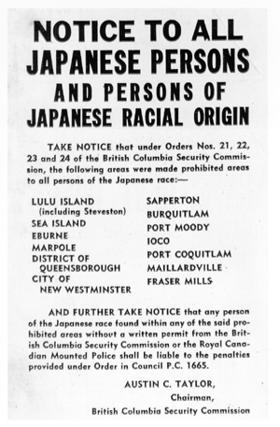
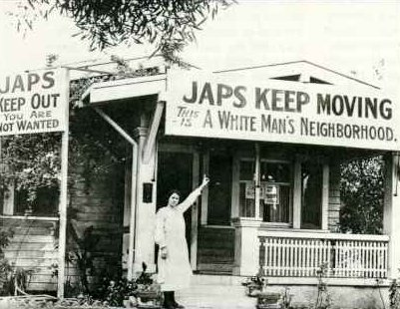
Canadian government promised Japanese-Canadians their property and finances would be returned upon release
Assets were sold off cheaply at auctions

Slide 86
Resettlement & repatriation
“It is the government’s plan to get these people out of BC as fast as possible. It is my personal intention, as long as I remain in public life, to see they never come back here. Let our slogan be for British Columbia:
“No Japs from the Rockies to the seas.”
- Ian Mackenzie, MP

Slide 87
Resettlement & repatriation
Following the war, internees were given 2 options:
Deportation back to Japan
Government offered free passage
Thousands of Japanese-Canadians were being sent to a country they had never known
Japan was completely destroyed by the war
Move east of the Rockies
Many relocated to Toronto
Reduced to “wage-earners”

Slide 88
Post-war
1947:
Canadian government launched a Royal Commission to examine compensation
1949:
All restrictions lifted from Japanese-Canadians
1950:
$1.3 million awarded to 1,434 Japanese Canadians

Slide 89
Redress
National Association of Japanese Canadians hired Price Waterhouse to estimate economic losses
Valued total loss to $443 million
1988: Brian Mulroney gave formal apology and announced compensation package:
$21,000 to each surviving internee
Re-instatement of citizenship to those deported
$12 million to the NAJC
$24 million to the Canadian Race Relations Foundation

Slide 90
Mary’s story
What part of Mary’s story…
Surprised you the most?
Disturbed you the most?
Imagine you are Mary… Based on any situation discussed in her story, write an entry in your diary describing your thoughts and emotions about that situation

