Slide 1
Canada: 1900-1914
Life in the early 1900s
Industrialization
Modernization

Slide 2
Complete the following sentences
Think about what Canada was like in the early 20th century…
The beliefs about a Canadian national identity were…
Women…
Significant conflicts that took place were…
Some major inventions include…

Slide 3
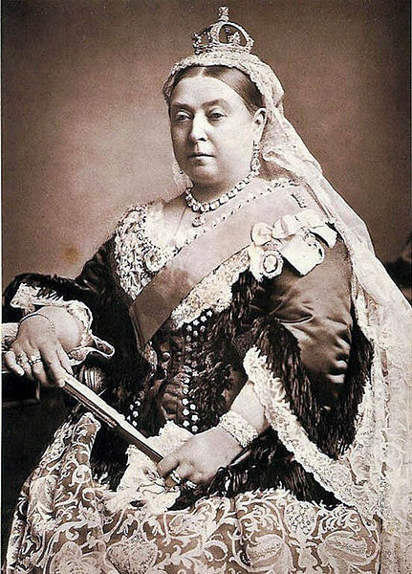
End of the Victorian-era
June 20, 1837 – January 22, 1901
Period of peace, prosperity, and national self-confidence
Millions emigrated to the US, Australia, and Canada
Queen Victoria’s reign stretched across the globe
Victoria = capital city of the first British Colony on the west coast (Vancouver Island)
Victoria day is still celebrated today,
honouring Queen Victoria’s birthday

Slide 4
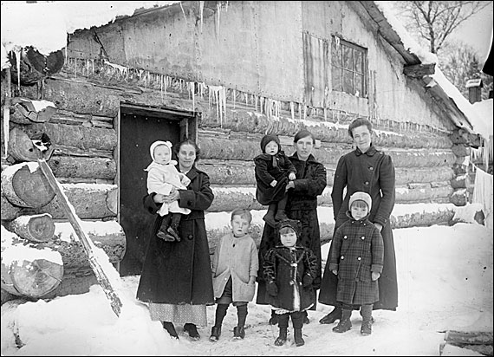
Most Canadians lived on farms or in small villages
But morals & attitudes were set by middle- and upper-class Anglophones
Little tolerance for those who did not obey the law
Ex. Death penalty

Slide 5
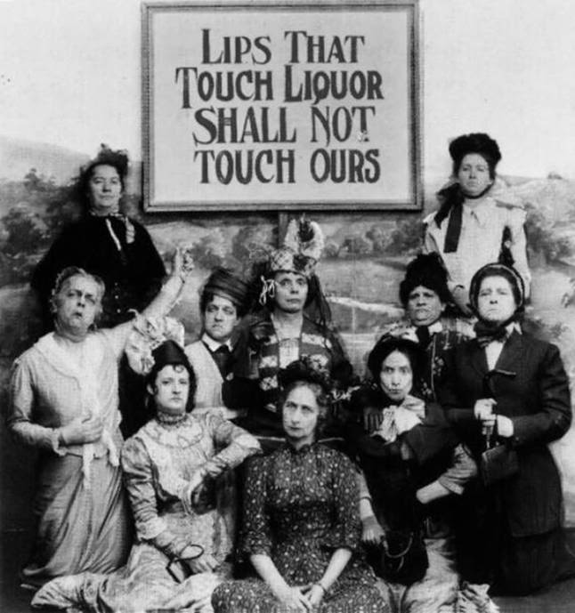
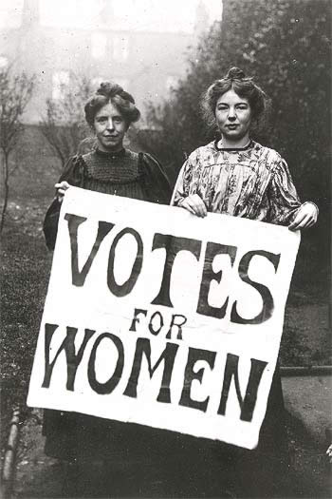
Women’s rights
Women’s Christian Temperance Union
First organization founded (in 1873) to campaign for women’s rights
Actively campaigned for prohibition & the right to vote
Believed alcohol was the reason for society’s problems
Also concerned about social problems
(Child labour, poverty, pollution, etc.)

Slide 6
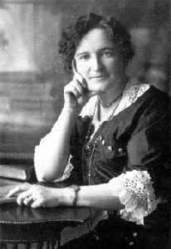
Women’s rights
Women were not considered persons under the law
Those who worked outside of the home were employed in stores, as servants, or factory workers
Salary was the legal property of her husband
Women were not even allowed to enter bowling allies!
Nellie McClung – famous suffragist
“The Famous Five”, launched the “Persons case”
Women should be eligible to sit in the Senate

Slide 7
An economic revolution
Canada known for abundance of natural resources
Timber, wheat, minerals, etc.
Relied heavily on an export economy
End of the 19th century marked the beginning of the biggest economic boom that Canada had yet seen
Surge in invention of new machinery & technologies
Hydroelectric power stations provided power to factories
= Enormous boost to industrialization in Canada
More jobs in manufacturing
Pulp & paper, railways, road building, etc.

Slide 8
An economy in transition…
Huge populations were moving to towns and cities
Population of Canada’s western cities EXPLODED
Rise in manufacturing = job opportunities in urban centres
BUT life was not the same for everyone in the cities
Significant contrast between the wealthy & the poor
Rich lived in luxury
Servants, electricity, heating, running water
Working class lived in shacks
No clean water + pollution from nearby factories = health problems

Slide 9
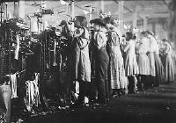
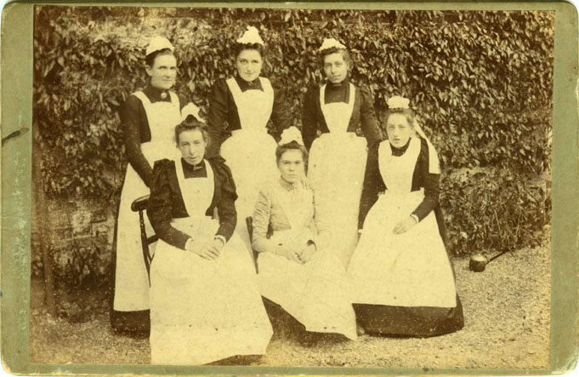
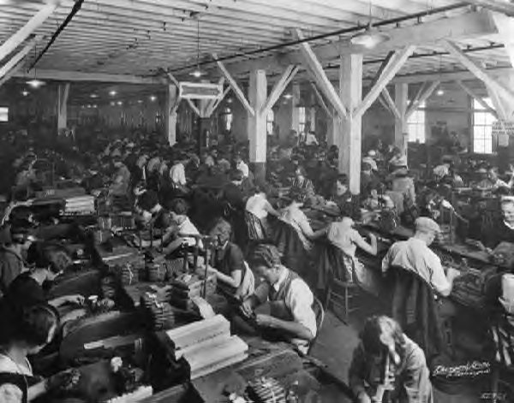
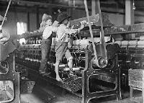
Women and children worked long hours for low wages
Restrictions on child labour were few and rarely enforced
Still, people were attracted to cities for jobs
and cultural and social opportunities

Slide 10
A few huge companies controlled much of the industry
No competition = high prices for goods
& low wages for workers
Workers formed trade unions
Better pay
Reduced hours of work
Better working conditions
If employers denied union demands, workers went on strike
Ex. 1913 coal miners in Nanaimo were on strike for 2+ years

Slide 11
Modernization in the early 20th Century
Horses
horse-drawn carriages, ploughs, fire engines, etc.
Bicycles
Henry Ford – Automobiles
Wright brothers – first flight in an airplane
Lasted only 12 seconds
Alexander Graham Bell – Telephone
Marconi – Radio
Silent films
Sports
World Series began in 1903
Bathrooms
Washing machines
Hearing aids
Vacuum cleaners
Eaton’s catalogue

Slide 12
Canada: On the road to independence

Slide 13
Some background information
In 1981, “being Canadian” meant honouring one’s Native, French, or British cultural traditions
In the 21st century, “being Canadian” applies to dozens of ethnic, religious, and linguistic groups associated with all parts of the world
Canada’s 1901 census counted 5,371,315
Nearly all were of British or French descent
French-Canadians did not spread out across the country like the English did
Canada’s First Nations were near invisible

Slide 14
Canada: a nation or colony?
Canada continued to depend on Britain to handle all international affairs
Result = Britain made decisions that did not have Canada’s best interest in mind

Slide 15
Alaska Boundary Dispute
A territorial dispute between the U.S.A and Canada
Controversy over a strip of land that runs down the Pacific Coast between B.C. and Alaska
Also involved a canal that provided access to Yukon
Foreign affair = controlled by London
1903: Britain decides the land belongs to the U.S.
Britain had just fought the Boer War; did not want to become involved in another international conflict
Canadians felt betrayed
Rise of anti-British emotions & a surge in Canadian nationalism separate from British identity

Slide 16
Boer War Canada’s first “foreign war”
A conflict in South Africa, involving 7,000+ Canadians
Between the British and Dutch settlers
English-Canadians urged the Canadian government to send help
Put Prime Minister Wilfrid Laurier in a tough spot
French-Canadians & immigrants from non-British countries disagreed with sending troops to a war halfway around the world
Henri Bourassa led the opposition

Slide 17
Sir Wilfrid Laurier
Leader of the Liberal Party
Became Canada’s 7th Prime Minister in 1899
Served as Prime Minster for 15 years
Known as “The Golden Age of Laurier”
Canada’s first French Prime Minister
Always tried to see both English & French points of view
Continually tried to work out compromises to please both language groups
“Two races share today the soil of Canada. These people had not always been friends. But I hasten to say it… There is no longer any family here but the human family. It matters not the language people speak or the alters on which they kneel.”

Slide 18
French-Canadian nationalism
French-speaking Canadians were extremely devastated by the outcome of the Alaska Boundary dispute
Saw themselves as Canadiens, not British subjects
Believed Canada should have autonomy
Language was another issue
Public Schools Act in Manitoba made English the only official language in the province
Eliminated the right to French-language instruction in schools

Slide 19
Canada’s changing population
Laurier realized that for Canada needed more people, especially in the West, in order to prosper
Launched an advertising campaign to attract immigrants from the United States and parts of Europe
It worked!
Settling into a new life in Canada was easy for those who were healthy and wealthy
Government sold land in the Prairies to those willing to farm for at relatively low cost
Loneliness & harsh conditions prompted many to move to urban centres

Slide 20
People already living in Canada did not share the same welcoming attitude towards the newcomers
Canadians were ethnocentric
Believed their own race or group was superior
Result: many newcomers experienced discrimination
Ukrainians & Polish people who settled in the Prairies were made fun of for their language and customs
Chinese, Japanese, and South Asians experienced the same in BC
Held jobs that Canadians considered too unpleasant
Cheap labour
Ex. hailing coal, packing fish, washing dishes, etc.

Slide 21
“British Columbia must remain a white man’s country”
- R. B. Bennett, 1907
Future prime minister

Slide 22
Chinese Immigration Act
Federal government’s attempt to limit Asian immigration
Passed in 1885 upon completion of the CPR
Every Chinese immigrant had to pay a head tax of $50
Later, this charge was raised to $500 per person (1903)
Equivalent to the price of a house or two years’ salary in China
Head tax was abolished in 1923 and replaced by the Exclusion Act, which banned Chinese immigration altogether

Slide 23
Canada’s First Nations people
Indian Act
Benefits:
Provided schools, medical care, hunting & fishing rights, tax exemption, and annual treaty payments
Drawbacks:
Denied the right to take up land, denied the right to vote, was incompatible with being a Canadian citizen
Lost “Indian Status” if they lived off reserves, joined the military, obtained higher education, or married a non-Indian

Slide 24
Designed to assimilate First Nations people into Canada’s mainstream culture
Gave the government control over how they lived and interacted with other Canadians
Reserves
Guaranteed that First Nations people would live away from the dominant society
Were not allowed to leave without government permission
Were encouraged to farm rather than hunt
Residential schools
Forced First Nations children to set aside their identity and traditions
Were taken away from their communities and sent to schools hundreds of kilometres away

Slide 25
Surviving…
Immigrants from similar backgrounds grouped together
“Bloc” settlements in rural areas
“Ethnic ghettos” in cities
All immigrant populations shared a common identity as being the poorest of Canadians
This era exposes Canada as an emerging yet intolerant place
A history of intolerance, racism, and exclusion…

Slide 26
Anti-racism posters
Discuss:
What are the causes of racism?
What message is the poster portraying about racism?
Is racism getting worse or disappearing in Canada?
What can be done to stamp out racism?

Slide 27
In-class assignment
What effect do you think your background has on the way you view Canada today?
Your perspective will determine how you view the past as well as the future…
Do you have a mostly positive or negative view of Canada’s future?
Give reasons for your answer.

